Slide 1
Detecting the Invisible People
https://liubolinstudio.com/projects/
Hsingchih Tang
Zhuo Xu
Guobin Huang
Notes:
Our team’s project is based on the Invisible Man artwork produced by Bolin Liu, in which the artist painted human bodies into the background of the pictures, and our goal is to detect the hidden human figures in his artwork. To begin with, I’ll firstly show a few images to give you a sense of how it looks like.

Slide 2
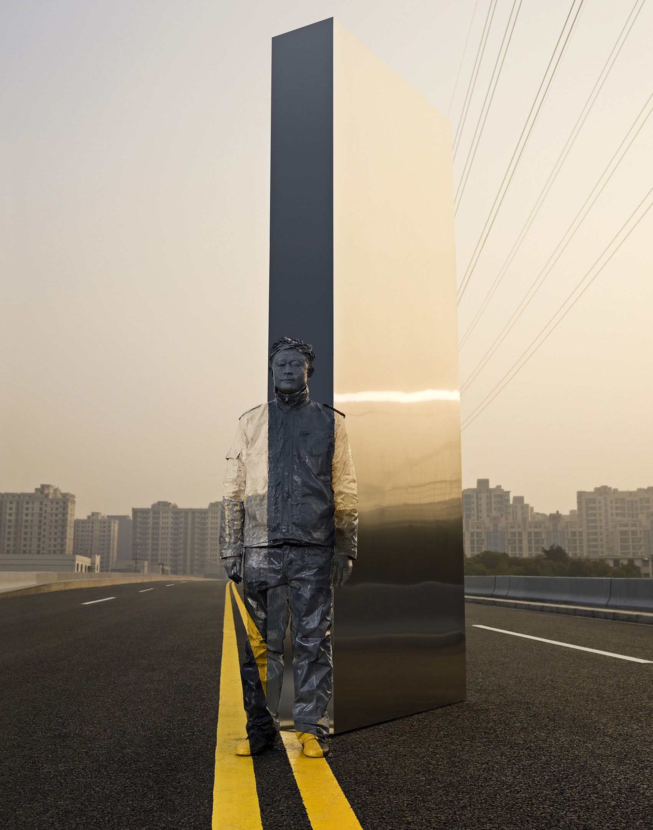
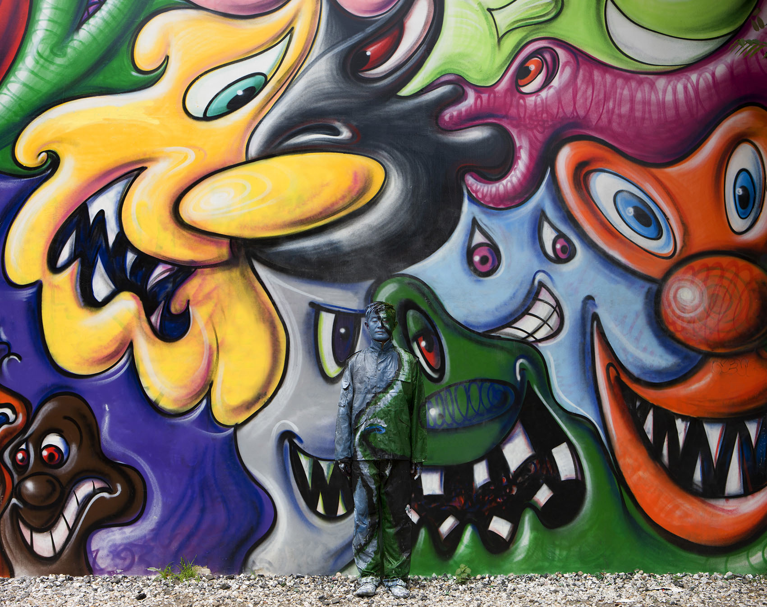
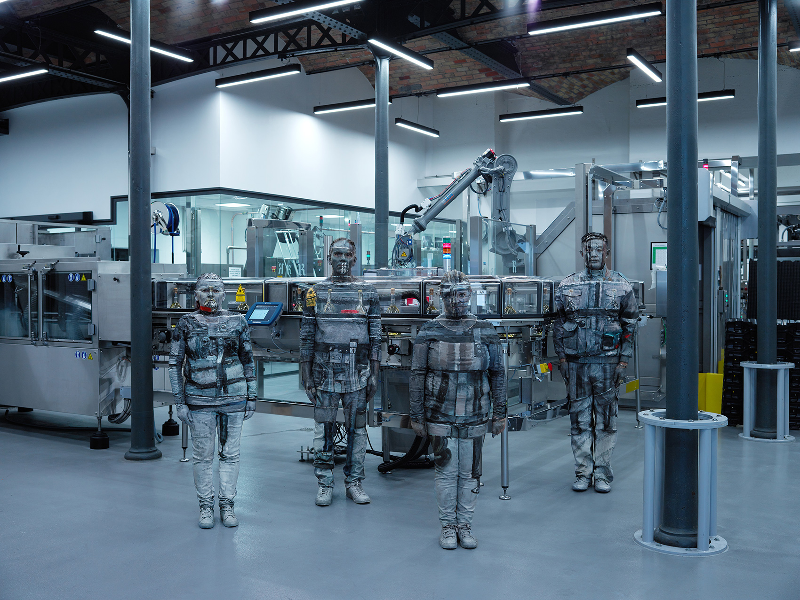
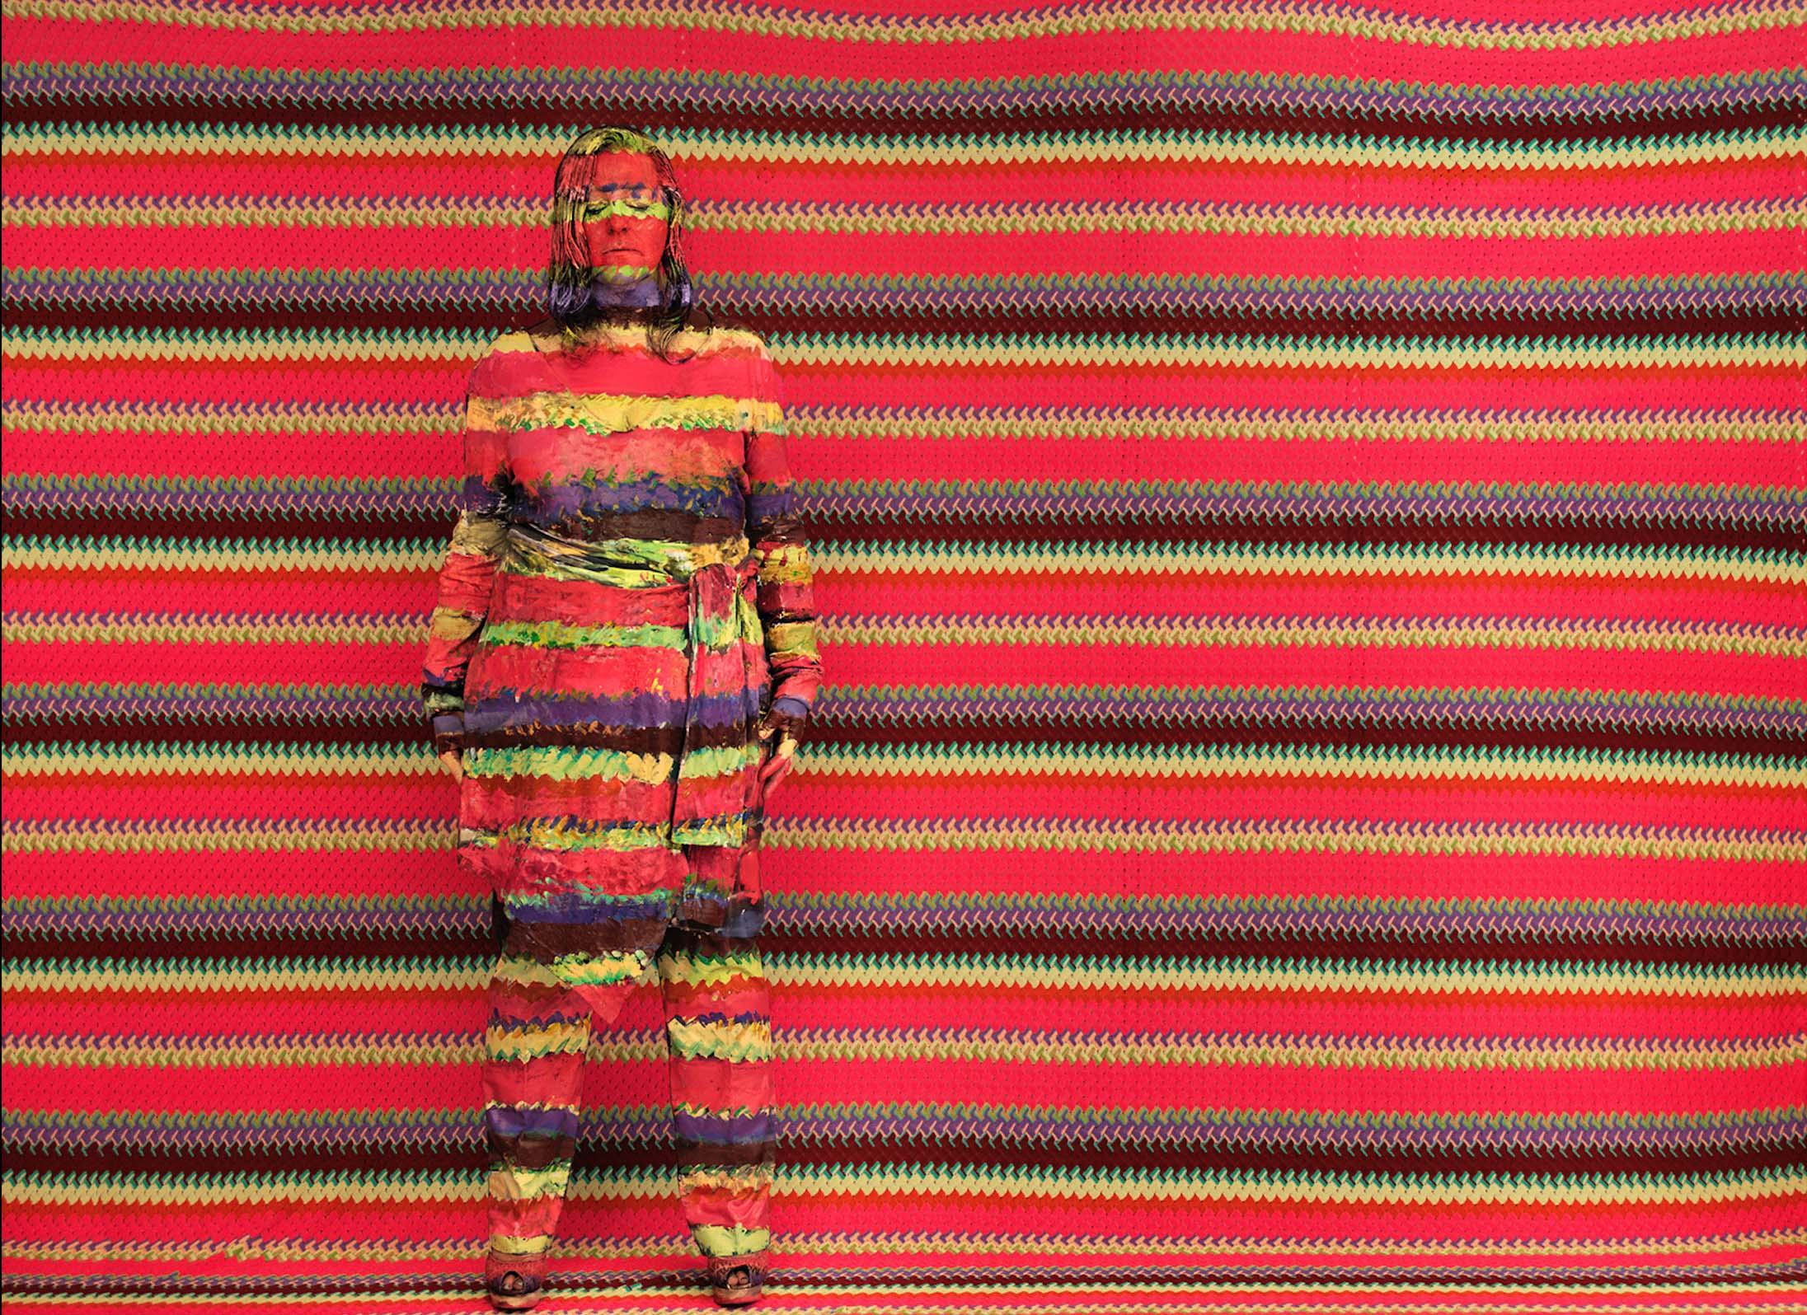
Notes:
As we can see here, each of the images has one human standing in the middle. And in this one, we have multiple people. And here is another one, and today we are going to use this image for our demo.

Slide 3
Approaches and Algorithms
Algorithm #1
Non-Local-Means Denoising
Edge Detection
Face Detection (DeepFace)
OpenCV Haar Cascade
Single Shot Multibox Detector
Multi-task Cascaded Convolutional Networks
Dlib
Weighted Filtering
Window Size
Weights
Threshold
Human’s face-to-body ratio
Algorithm #2
Otsu’s Method
Fast Fourier Transform
Repetitive pattern removal
Edge Detection
Notes:
We explored several image processing techniques and toolkits listed on this slide, and eventually we have combined them into two different algorithms. Now, I’ll explain the first one.

Slide 4

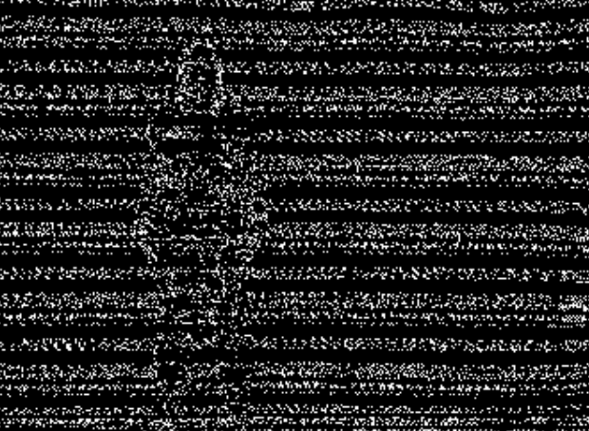
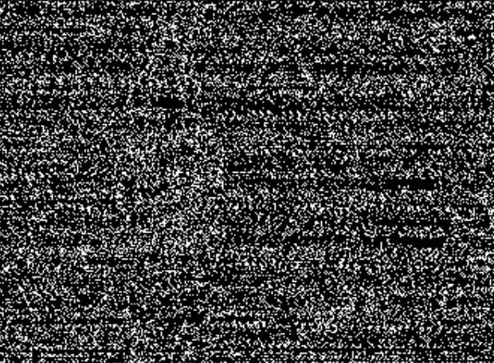
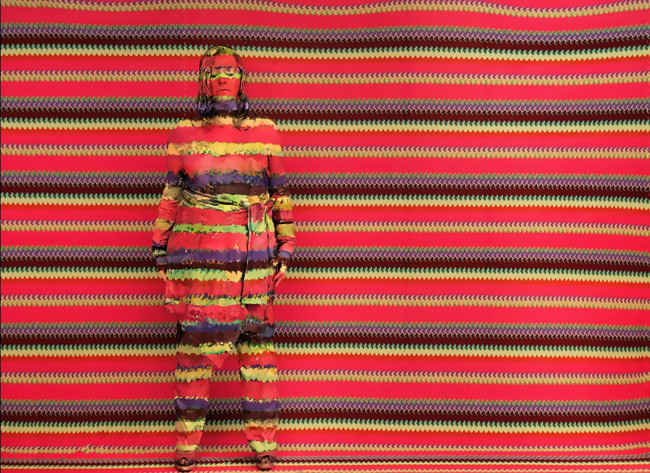
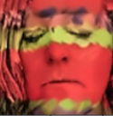
Algorithm #1
NLM Denoising
Edge Detection (John F. Canny)
Face Detection (DeepFace Dlib Model)
Weighted Filtering in Small Windows
Notes:
I used the standard non-local-means denoising function provided by the OpenCV library, as well as its edge detection function. The effect of the non-local-means denoising step is pretty obvious if we compare the edge detection results on the original image and the denoised image.
In order to locate the human figure in the image, I used the open-source DeepFace API developed by Facebook Research to detect the face of the hidden person. This API provides face detection using different models such as Haar Cascades, convolutional networks, Dlib, etc. And after several experiments, I found out that the Dlib model worked the best.
Afterwards, I applied weighted filtering on each pixel to find out whether or not it belongs to the human body or the background. Here the blue squares are some examples of the filtering windows. Also, I only processed pixels within a certain area, because we know that the human body usually does not occupy the entire image. The size of this area is proportional to the width and height of the detected face region.

Slide 5
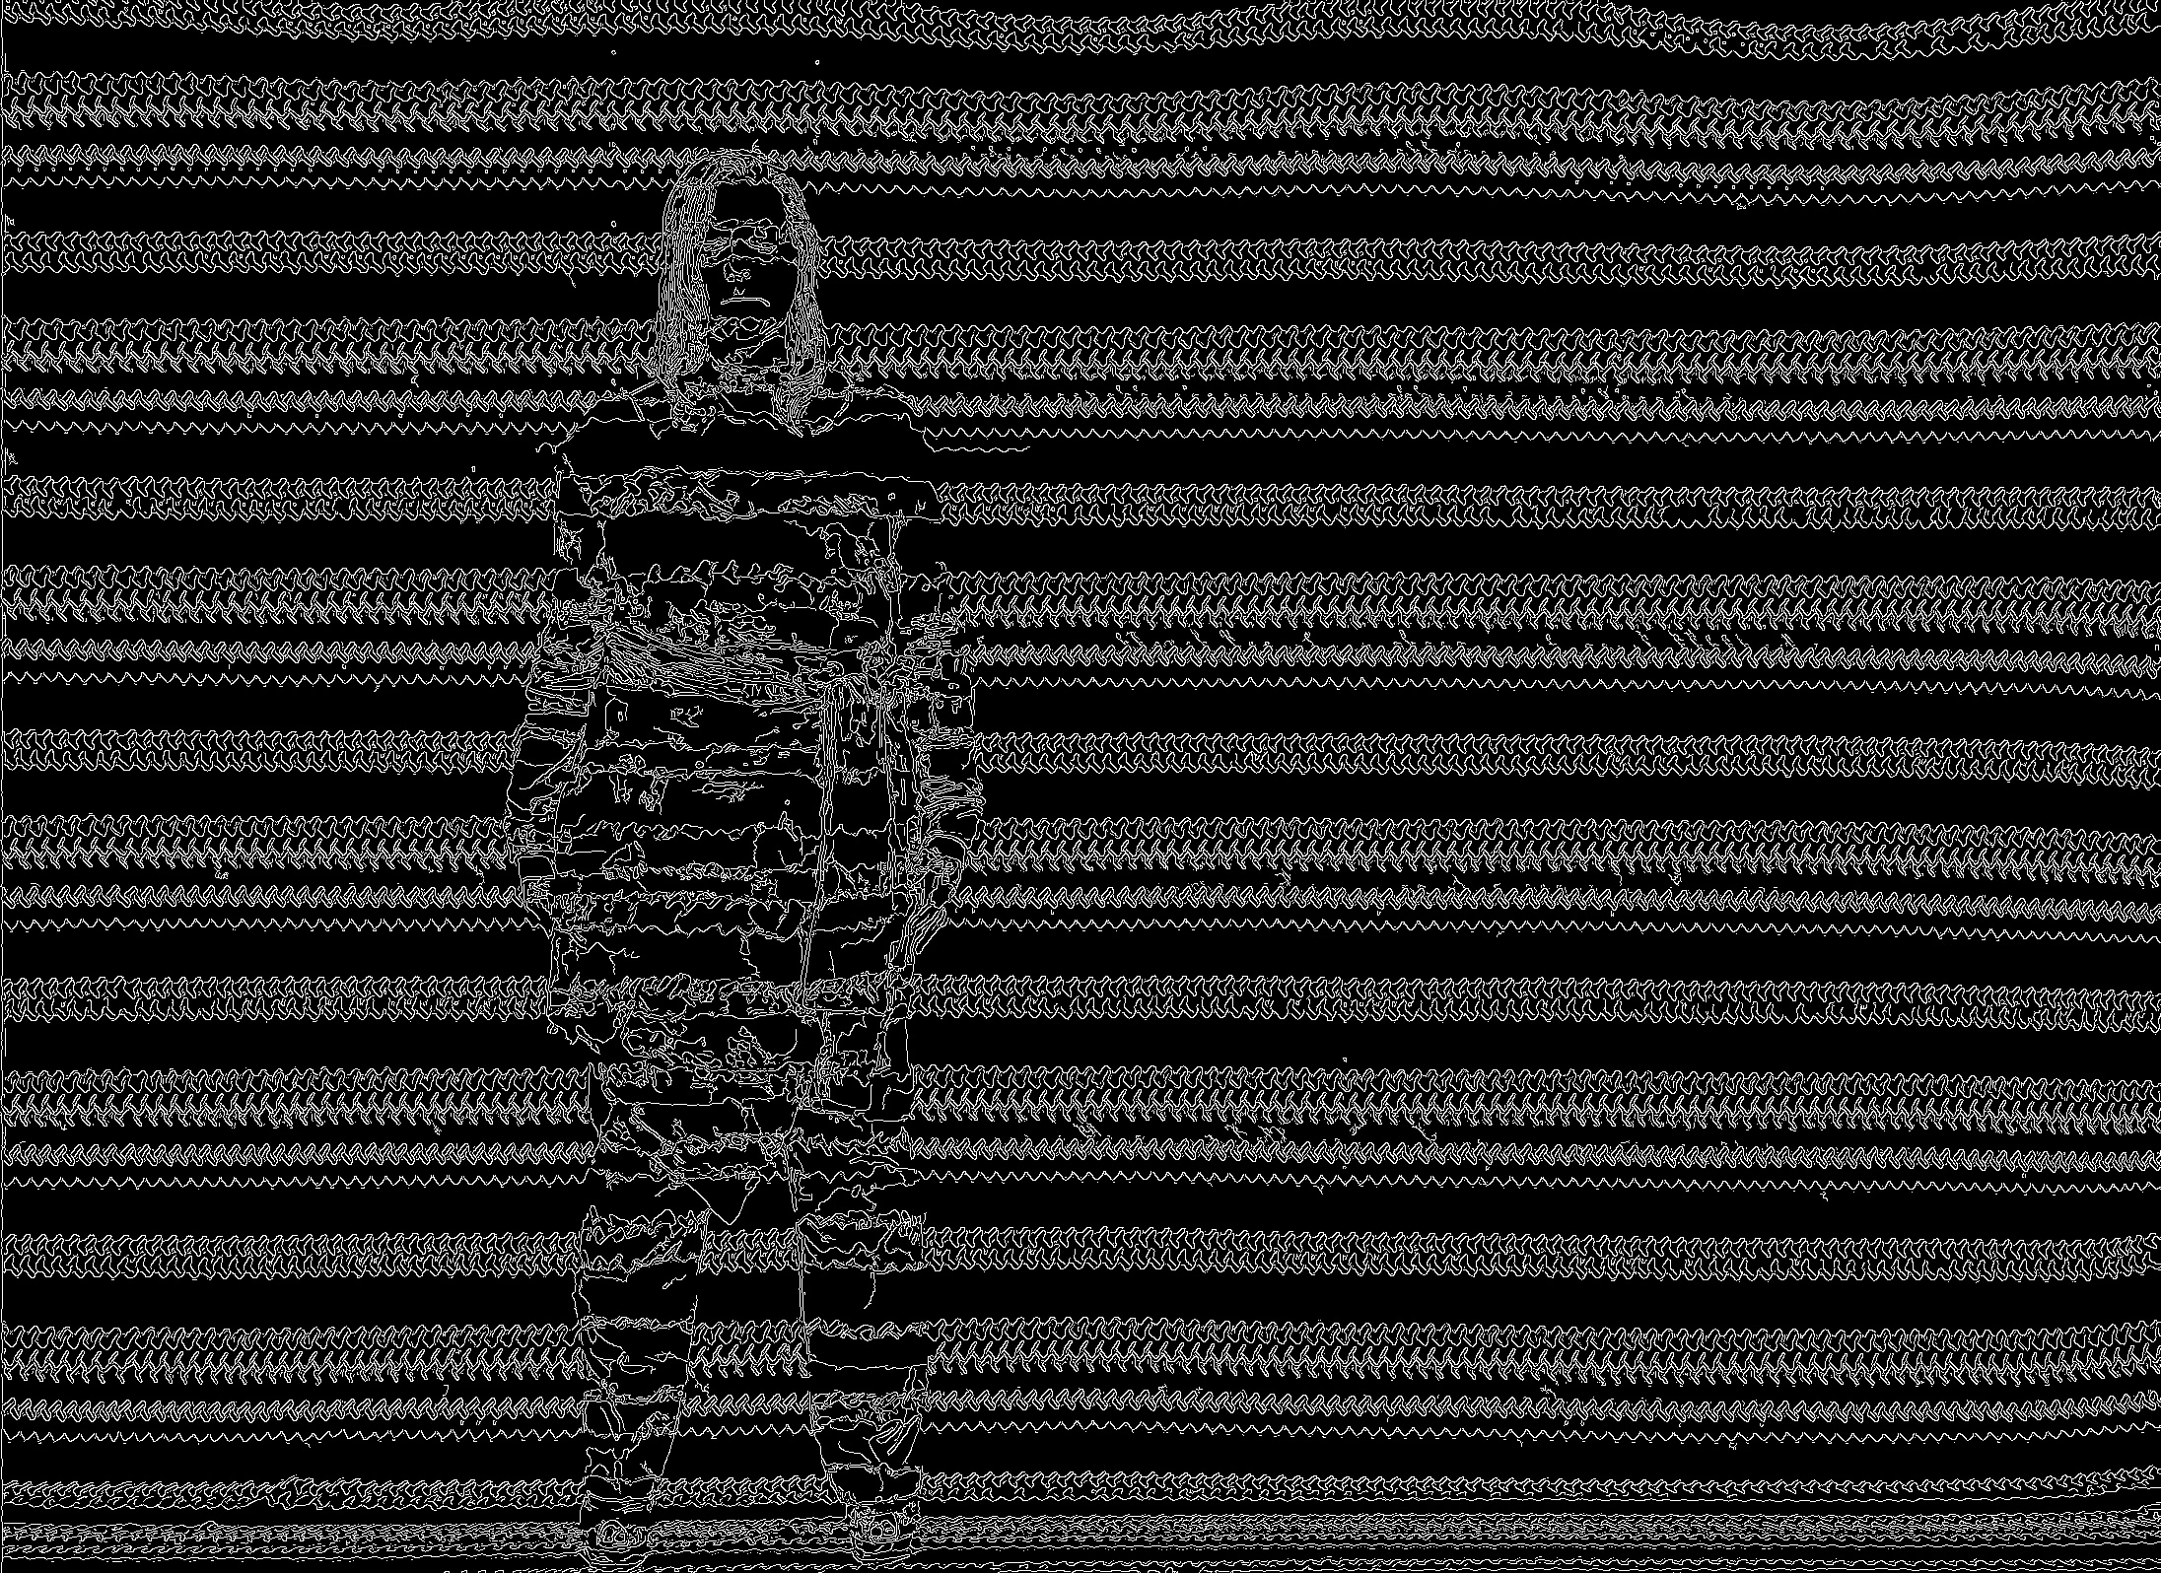
Algorithm #1
0 | 1 | 1
0 | 0.5 | 1
0.5 | 0.5 | 0.5
Edge weight = 0.5
Body weight = 1
Threshold = 0.5
Filtered value = (0.5*4+1*3)/9 ≈ 0.56
Notes:
Here is a very simple illustration of the weighted filtering process. Of course the actual window size is much larger than 3 by 3.
I start by classifying all pixels in the detected face region as part of the human body — in other words, the foreground — and assign a weight of 1 to each of these pixels.
If there is a pixel in the window that has an edge on it, but this pixel hasn’t yet been classified as the foreground, then I’ll assign its weight to be a smaller value, for example 0.5. At the end, if the weighted average is greater than a threshold value, then I’ll classify the center pixel as the foreground.

Slide 6
Algorithm #1
0 | 1 | 1
0 | 1 | 1
0.5 | 0.5 | 0.5
Update this pixel
(classify as human body)
Notes:
This pixel will then be updated, and contribute to the filtering process on the other neighboring pixels. For time reasons, I’m not going to get into too much implementation details here.

Slide 7
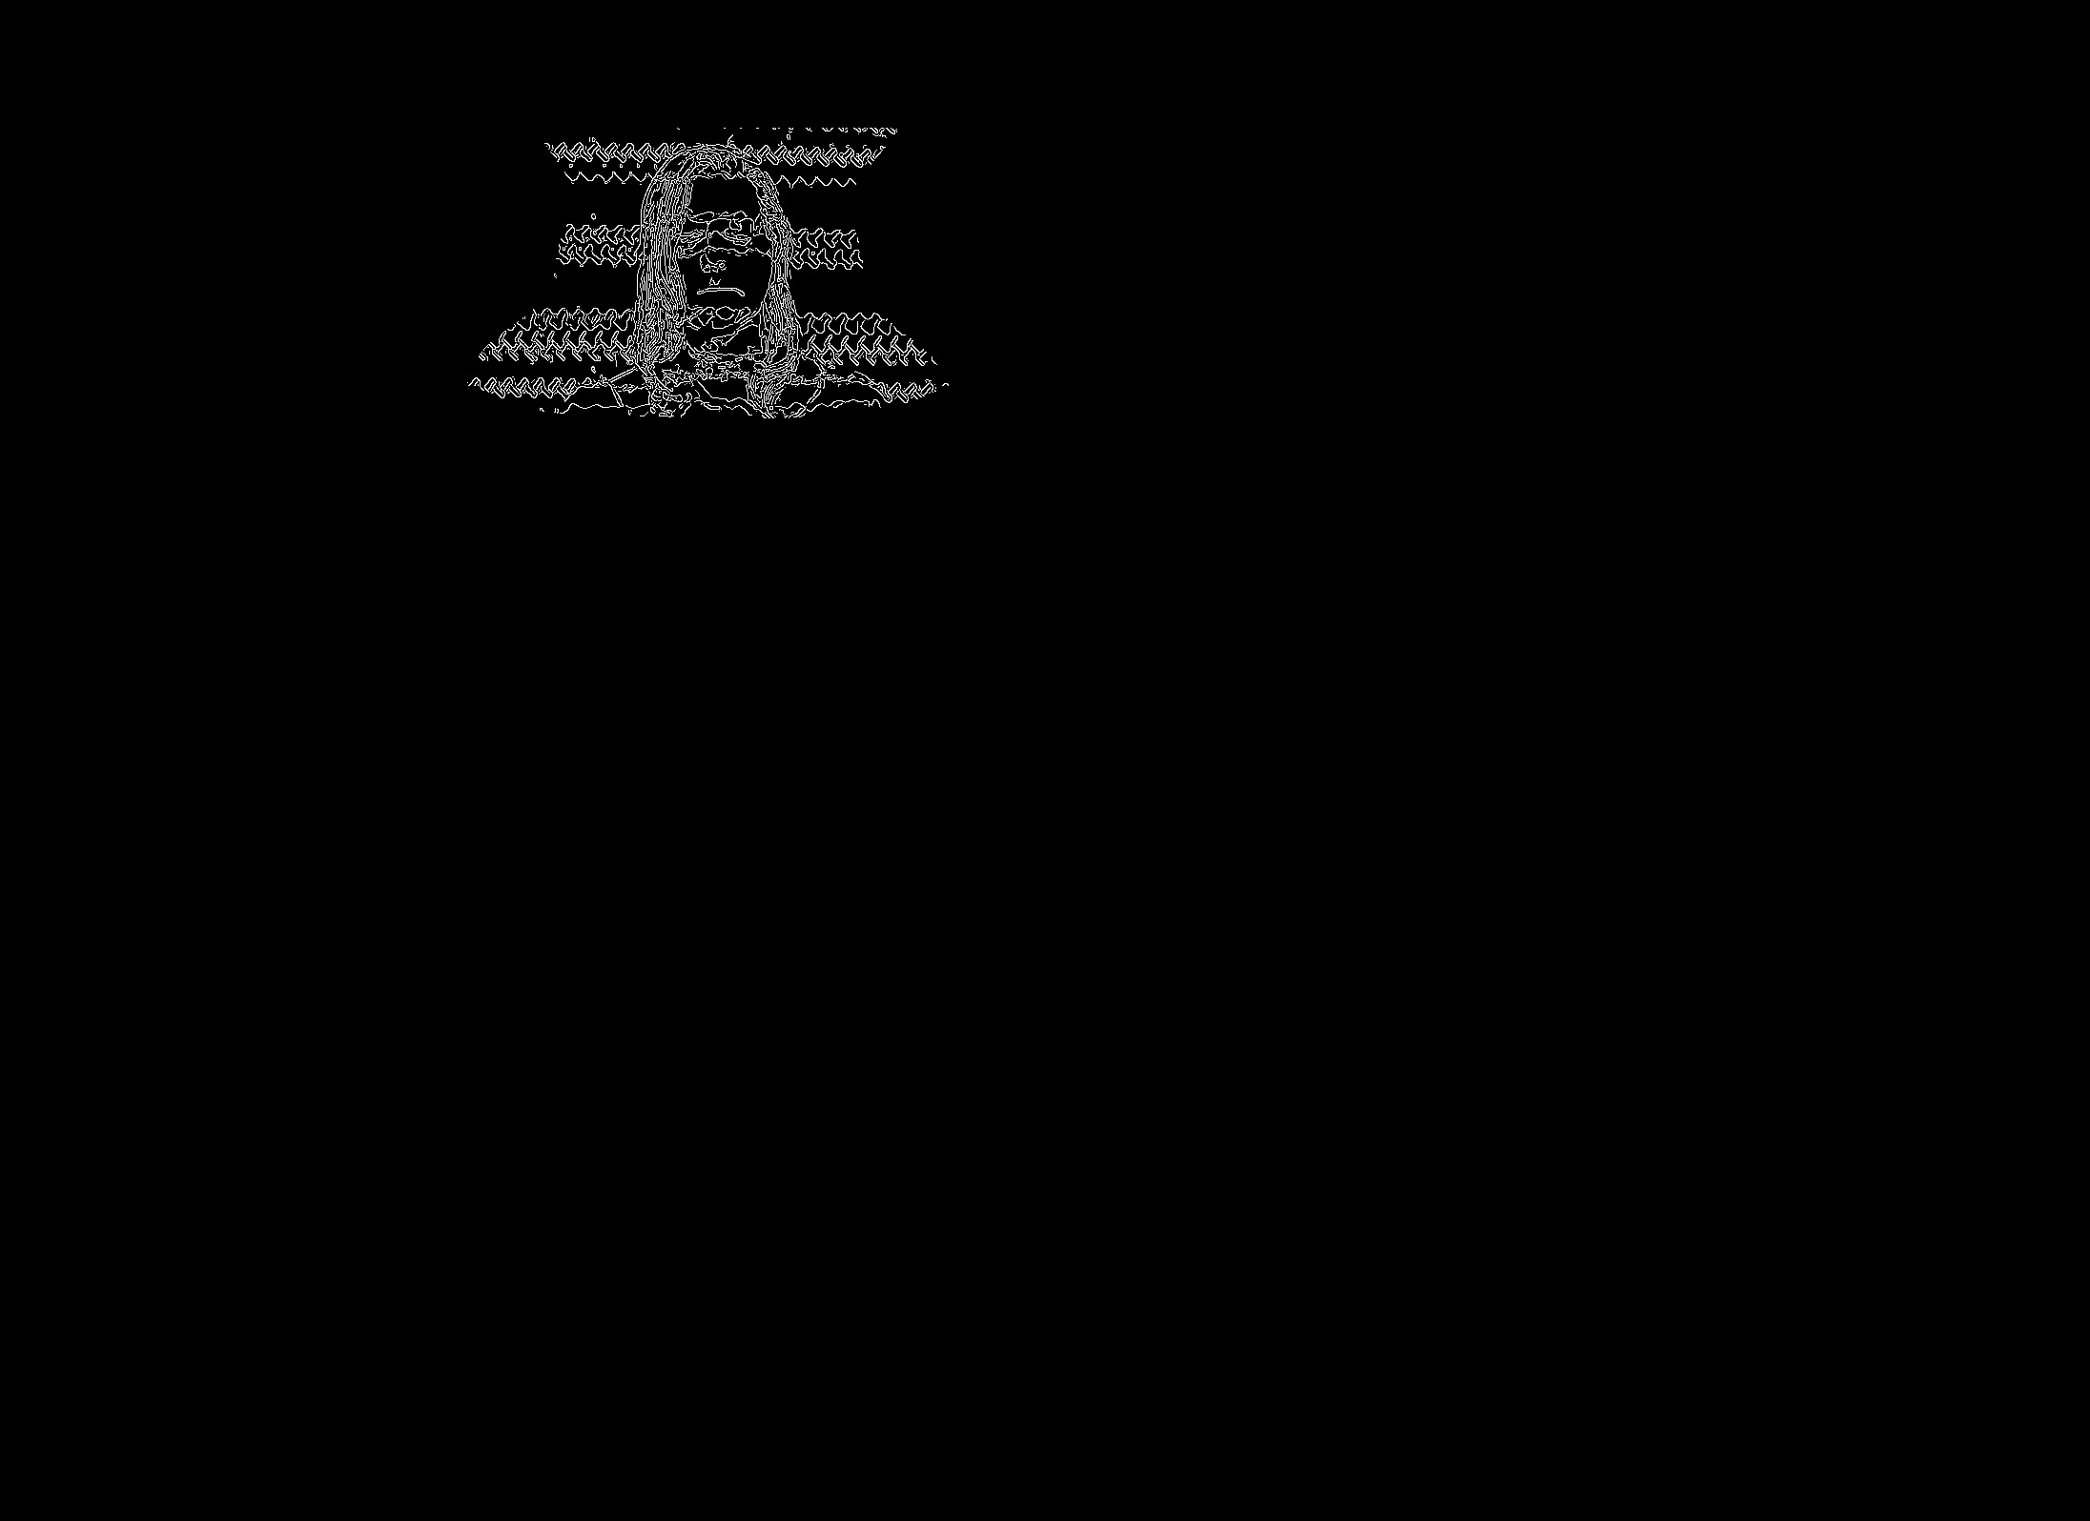
Algorithm #1
Notes:
And here is my final result on this image. It’s not super ideal, but the algorithm also produced better results with some other pictures.

Slide 8
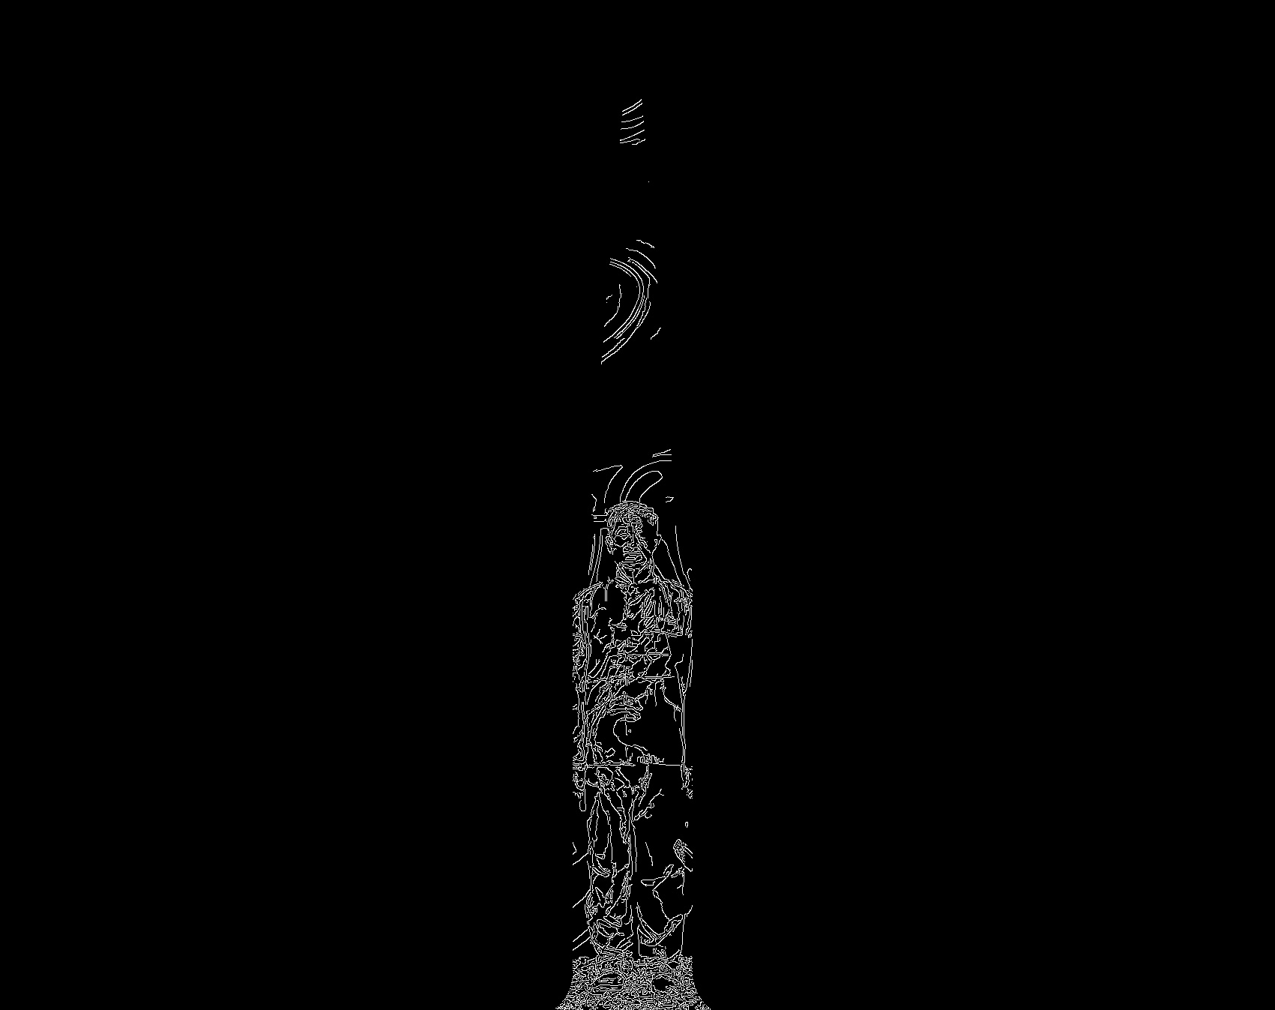
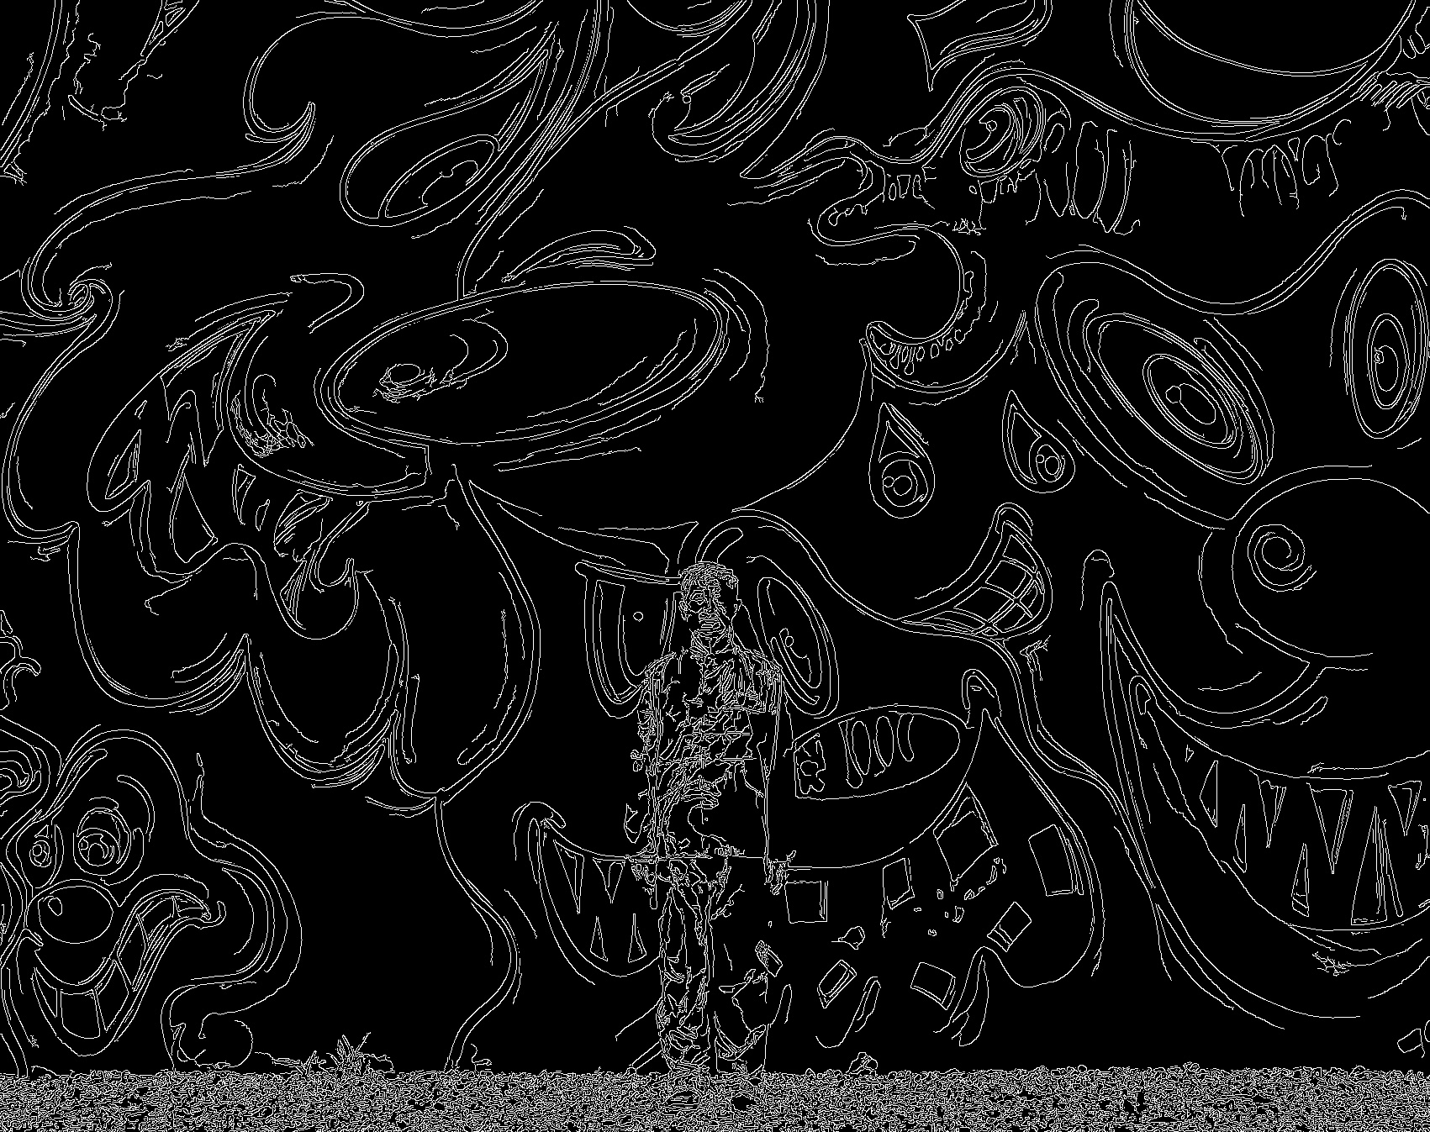
Algorithm #1 – more examples
Notes:
For example, this one.

Slide 9
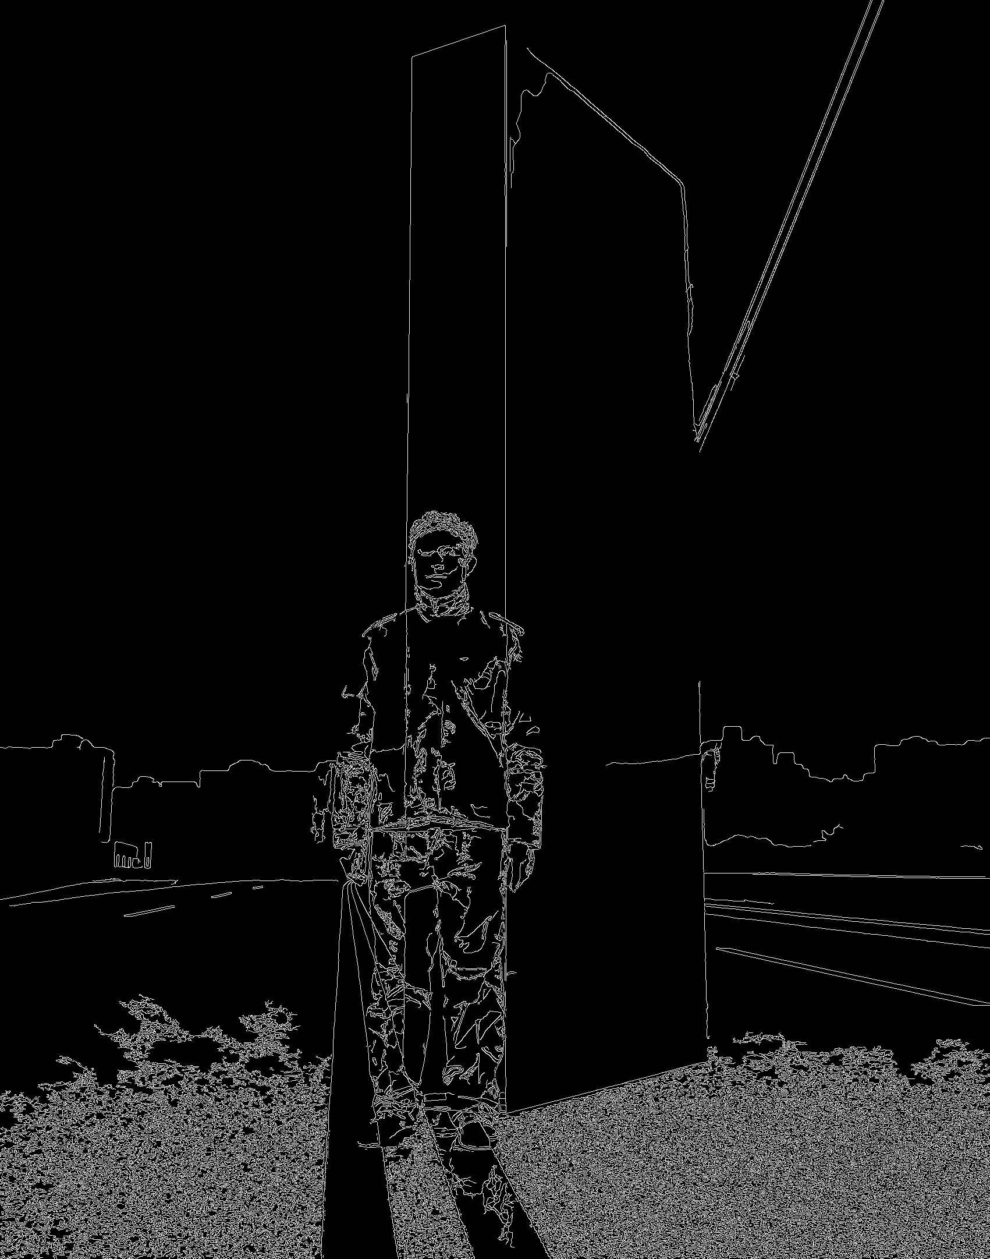
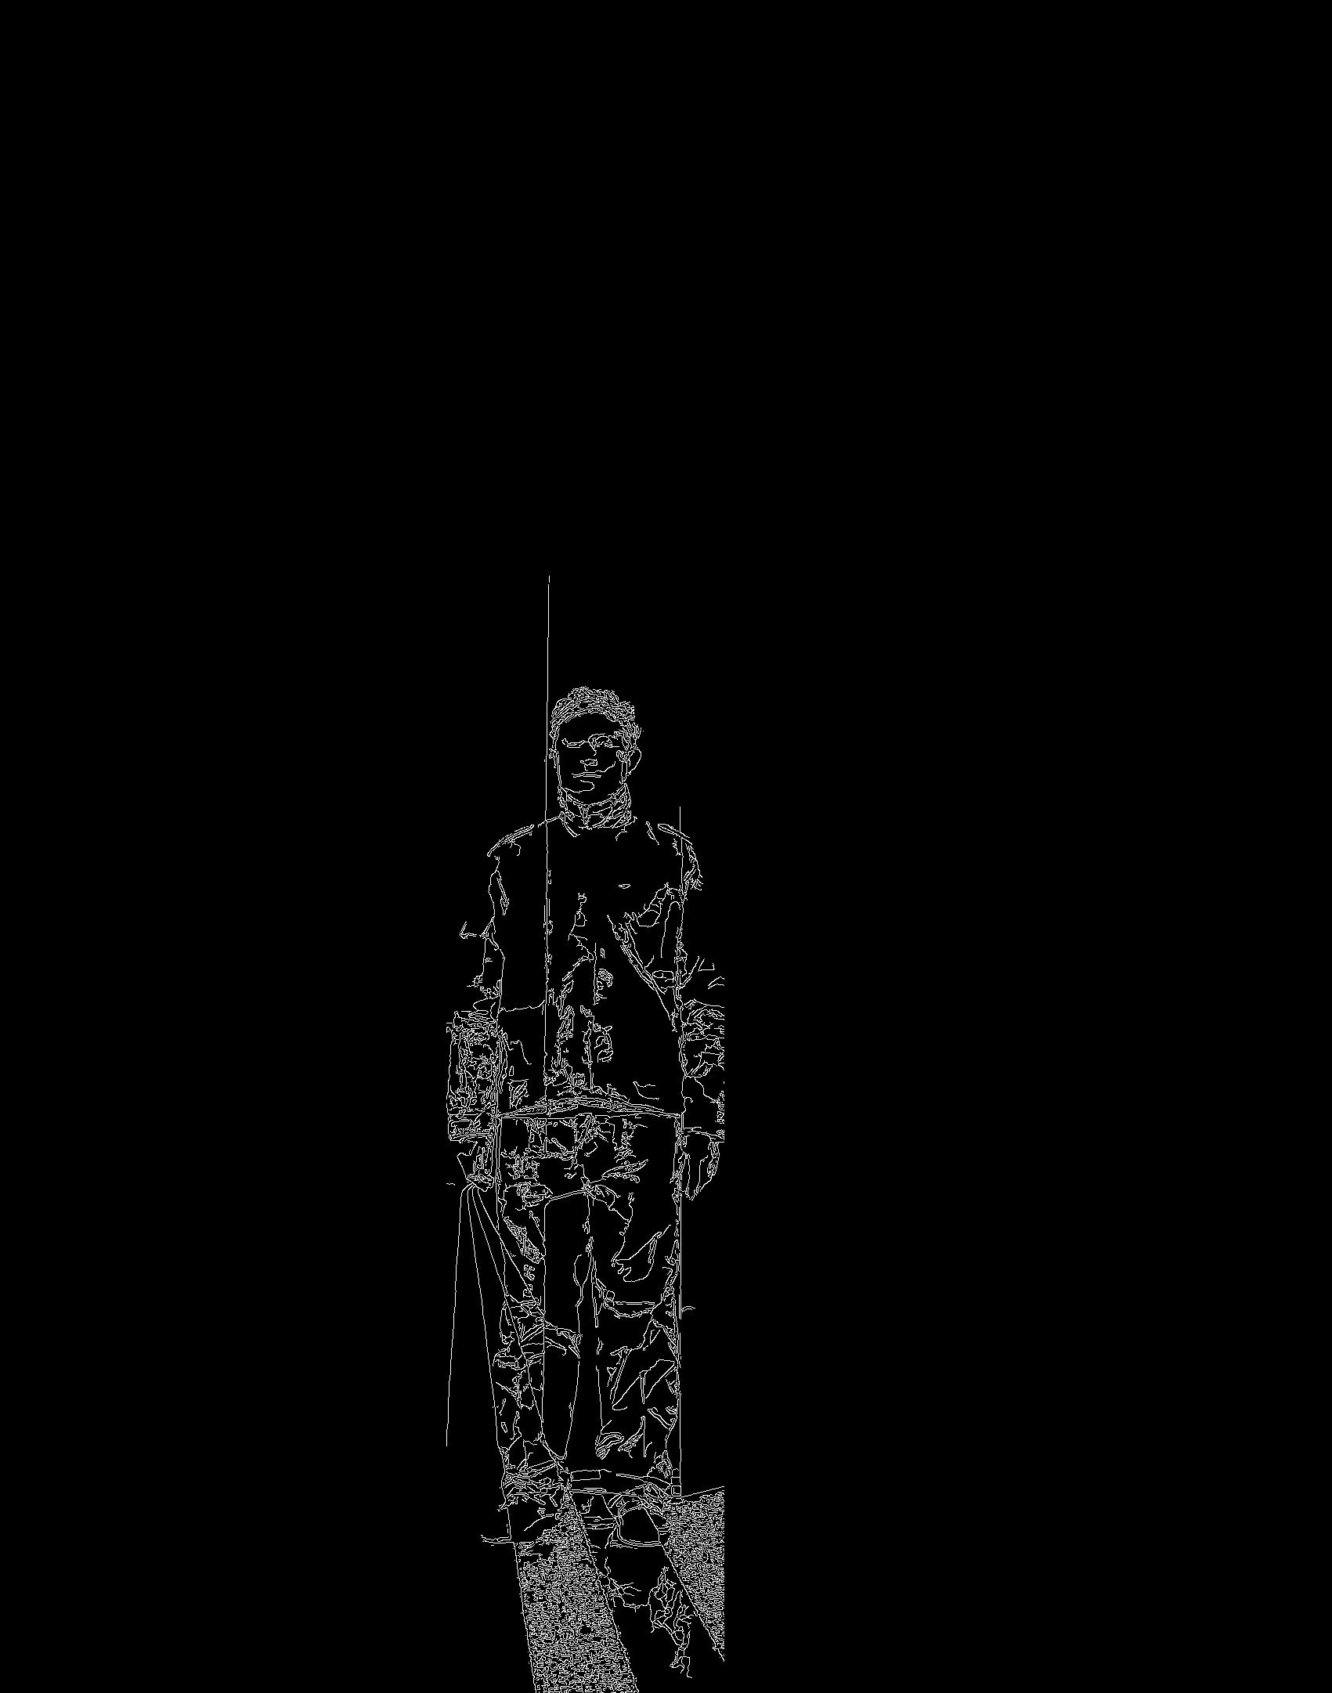
Algorithm #1 – more examples
Notes:
And this one.

Slide 10
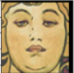
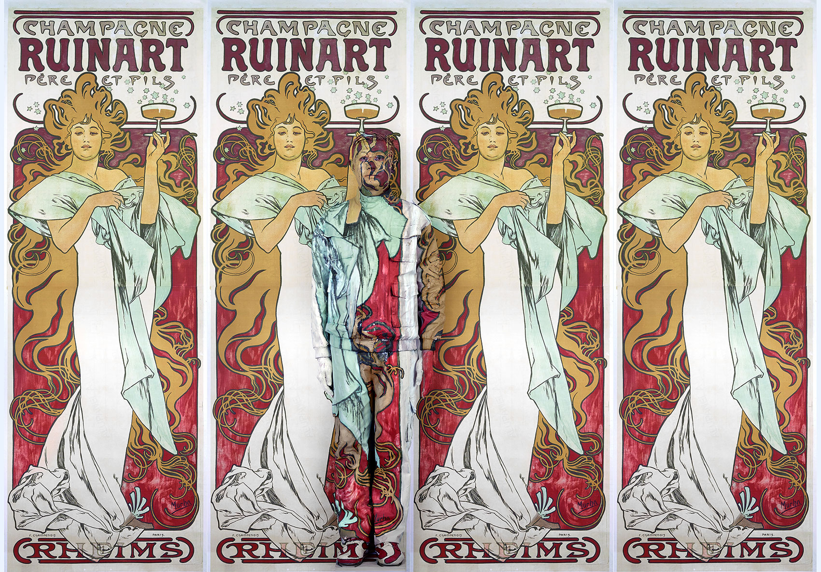
Algorithm #1 – more examples
Notes:
Of course, the algorithm is heavily dependent on the success of face detection. When running the program on this picture, the face detection failed to capture the real human face, and instead it found the face on the painting, which is a funny accident.
All right, now I’ll give the stage to my teammates to talk about the second algorithm.

Slide 11
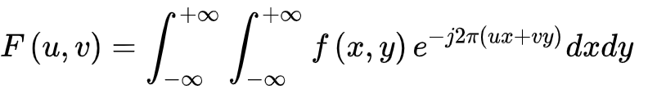
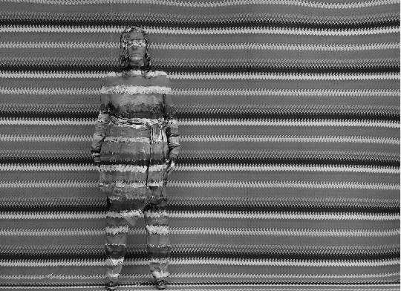
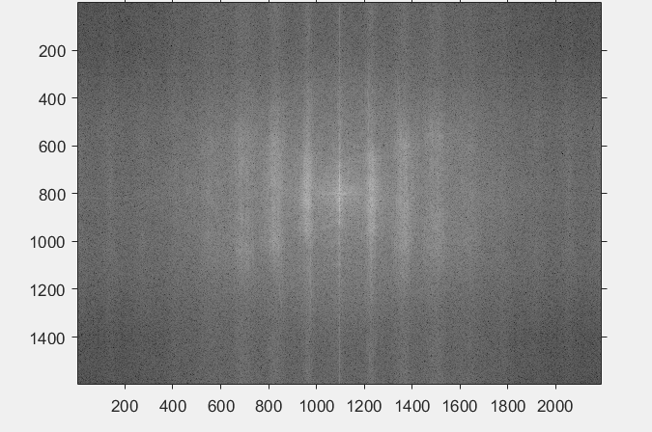
Algorithm #2
Fast Fourier Transform to Remove Repetitive
Original Image
2D Fourier Projection
Notes:
We notice there are repetitive patterns in such picture. If we can remove those repetitive patterns, our segmentation result may be more promising. We decided to use fast fourier transform to remove these repetitive patterns.
Fast Fourier Transform is a way to convert a signal from its original domain, in this problem, it’s a space domain to a representation in the frequency domain. We can see from this original image to its 2d fourier projection. It’s composed of different frequencies of planar waves. The center part is the low frequency part, it denotes main body of the picture in the space domain. While the around part is the high frequency part, it denotes the details and edges of the picture in the space domain. Also, the intensity in the 2D Fourier Projection denotes the repetition of current frequency signal.

Slide 12
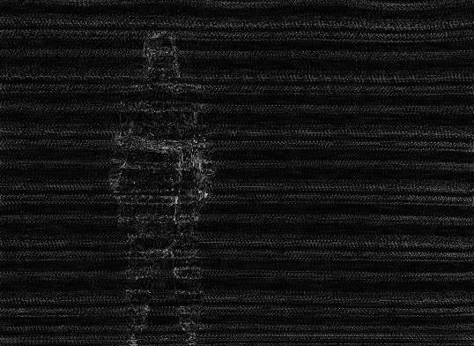
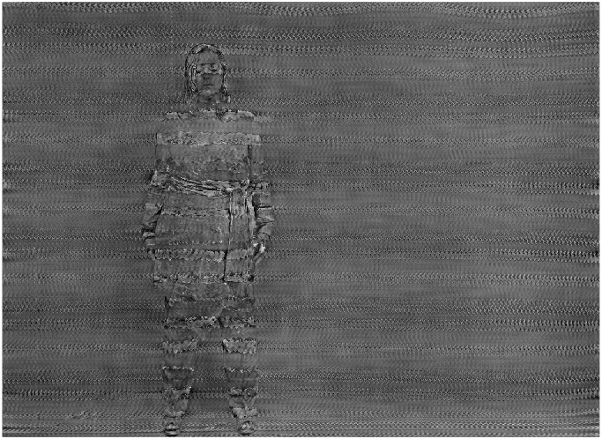
Algorithm #2
Fast Fourier Transform to Remove Repetitive
Restored Picture without Low Pass
Restored Picture with Low Pass
Notes:
So we do two things in the frequency domain: Firstly, we find out the intensity that’s greater than one threshold and zero them out and restored. We tried several times to find the best threshold. But we forgot to let the low frequency pass, which result in the picture of left, we can only get a tons of points, but lose the picture of the main body. Then we try to not zero out the low frequency part, the main body in the space domain was preserved, and result seems better than the left one.

Slide 13
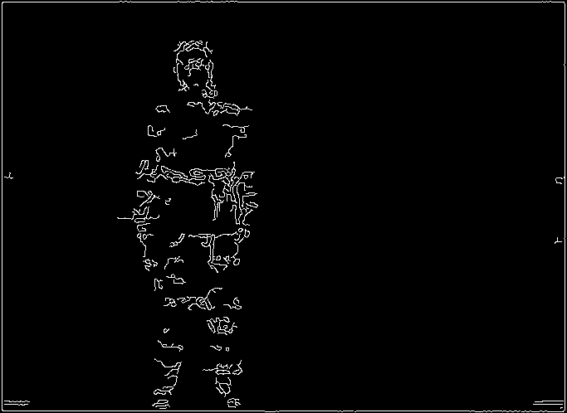
Algorithm #2
Notes:
After removing periodical repetition items. We got an image with smoother background. Therefore, we can use edge detection to detect the human body in the image. The right side is the edge with Canny filter and threshold 0.4.

Slide 14
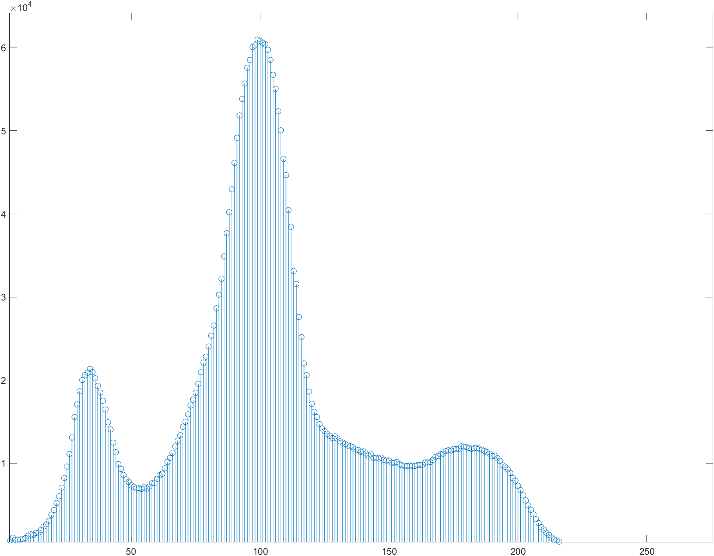
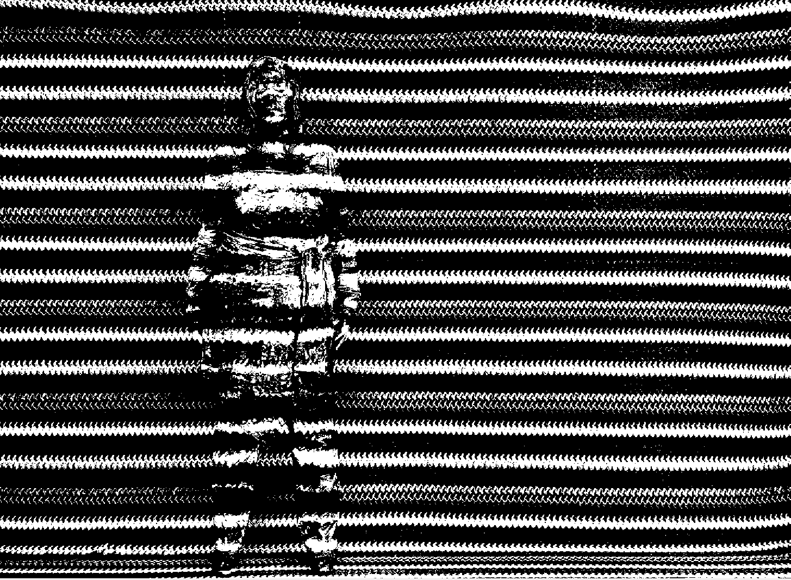
Algorithm #2
Otsu’s Method
Notes:
We also tried some traditional segmentation method in this problem. However, I think traditional segmentation method is not very suitable for this kind problem, since the traditional method is playing on the similarity of gray scale in one region, and detect edge on those drastic change area. In this problem, this idea is not very suitable, since the actor was trying to smooth his bounds with the background. The complicated background making the segmentation harder. We can see the result of otsu’s method. Otsu method is not ideal for such complicated picture.

Slide 15
Moving Forward
Algorithm #1
Training on parameters
Better Face Detection Tools
Runtime
Algorithm #2
Better Repetition Removal Tools
Generalized applications
Notes:
Going forward, our algorithms still have some space for improvements.
For the first one, the weighted filtering step uses many parameters such as the window size, the weights, the threshold and so on. If possible, we could incorporate some machine learning techniques to train these parameters to achieve better results.
Also, as mentioned earlier, the face detection tool is key to the success of this algorithm, therefore finding a better toolkit will make the results more accurate.
At the end, the face detection and weighted filtering steps are relatively time consuming. So the runtime is also something I’d like to improve on.
For the second one, we used fast fourier transform to remove repetition signals. It works well in periodical repetition. Finding a repetition removal method that works on non-periodic repetition would improve this. Also, as we discussed, the method relys on repetition removal therefore, for images taken with non-repetition background, this method can’t perform well.

Slide 16
Thanks!
Any question?
Hsingchih Tang
Zhuo Xu
Guobin Huang
Notes:
That’s all about our project. Thank you very much for watching!

